Slide 1

Maester
Your Microsoft 365 test automation framework
<Presenter Name>
<Title/Organization>
1 / 15

Slide 2
Gartner predicts that through 2025, more than 99% of cloud breaches will be traced back to preventable misconfigurations or mistakes by end users.
https://venturebeat.com/business/takeaways-from-gartners-2021-hype-cycle-for-cloud-security-report/
Notes:
Talk about how this Gartner’s prediction from 2021 is our new reality.

Slide 3
Insecure configuration of identity platform
Misconfigurations and exposure of identity platforms and their components are common vectors for attackers to gain unauthorized high-privilege access.
Microsoft Digital Defense Report 2023
aka.ms/mddr
Notes:
Talk about how Microsoft is seeing this same problem in tenants that are compromised.
aka.ms/mddr

Slide 4
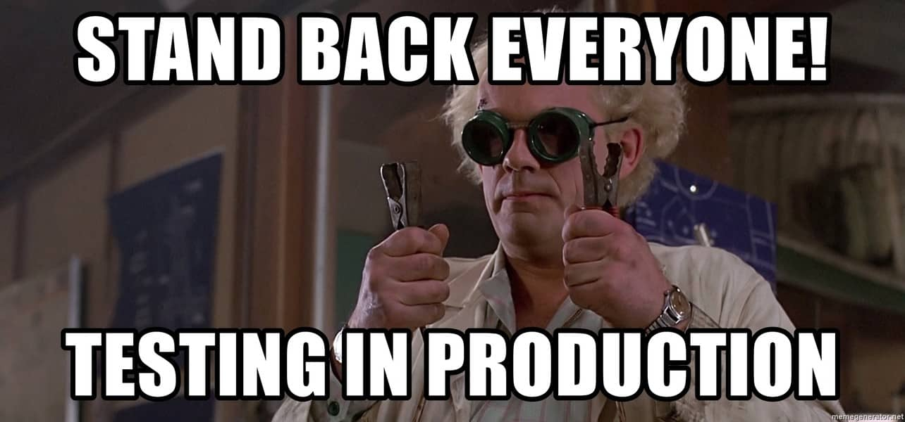
Notes:
Unfortunately, this is how most Microsoft 365 tenants are administered in production today.
At least in this meme they are doing some form of testing.
Let me tell you about a customer that had a conditional access policy enforcing MFA for their guest users. Somebody was doing a clean up and removed all the users from this group AND NOBODY NOTICED IT FOR A YEAR!!!
How confident are you that your environment doesn’t have this issue or a variation of this?

Slide 5
Notes:
Okay maybe not the speed (when you start) but over time the tests will help you.

Slide 6
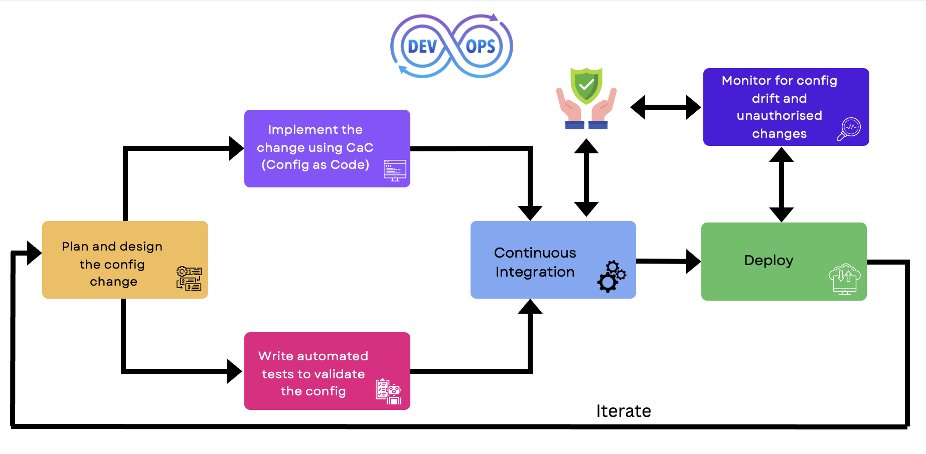
Maester
Maester
Notes:
Use this to explain Maester’s place in the DevOps lifecycle.
Talk about how we can bring mature DevOps practices to managing Microsoft 365 tenants and their security configuration.

Slide 7
The Demo
Running Maester

Slide 8
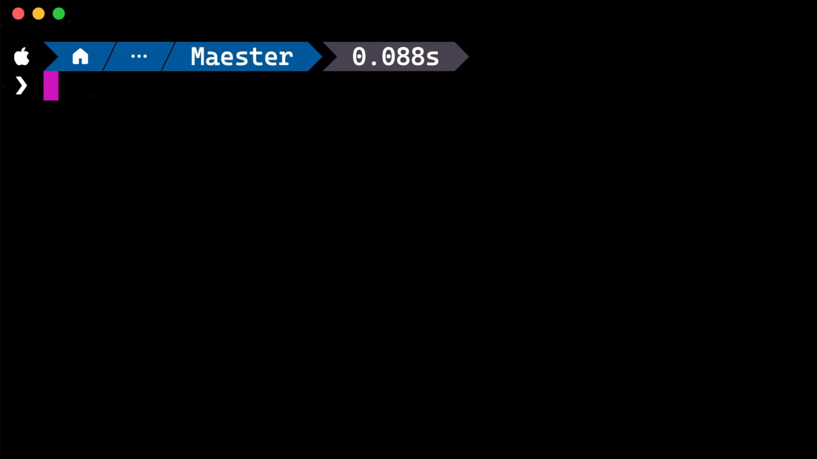

Slide 9
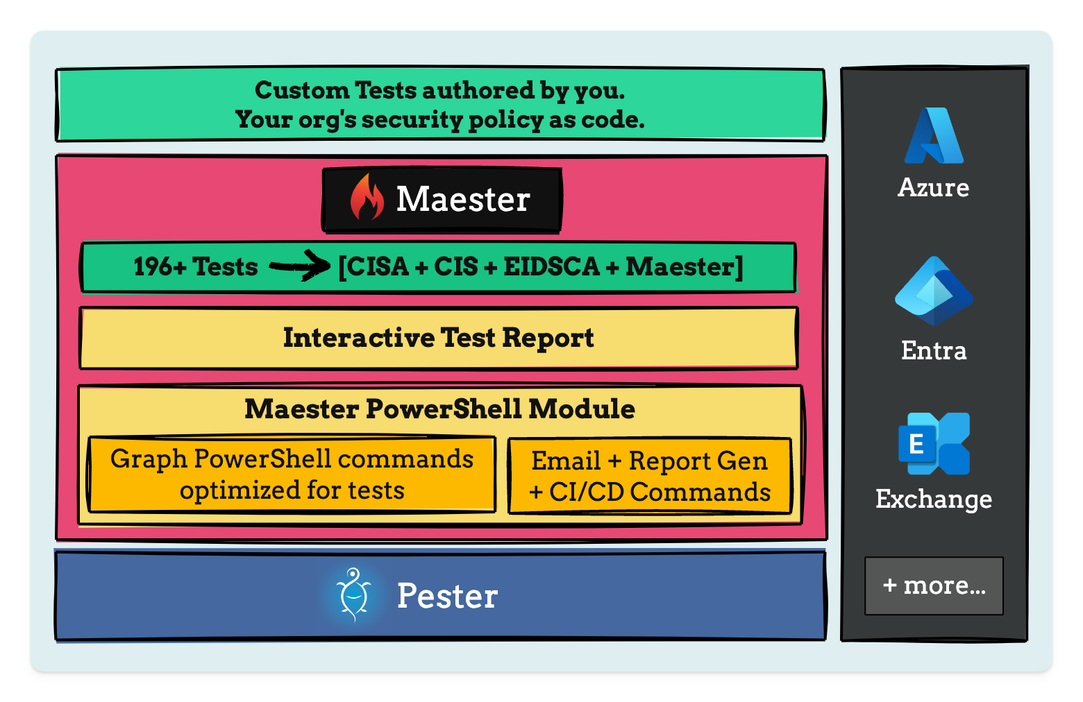
Maester Framework
Notes:
Start from the bottom up to explain the architecture.
Talk about Pester framework, how it’s used in PowerShell for unit testing
Talk about the Maester PowerShell module and how it embeds the tests and the report inside the PowerShell module.
Open one of the reports you ran and show the tests, click through and show how there are instructions to fix them. Open a test that shows items in the result (e.g. CA policies that might not have an emergency access account configured).
Talk about the out of the box tests and integrations for Azure, Entra, Exchange, Teams

Slide 10
Why Maester?
With Maester we want to make Pester approachable to more IT admins and cybersecurity teams.
PS. Have you seen the Pester test results 😱?
We spent time improving the test results,
Easy navigation with deep links to the Microsoft Admin portals
Step by step, simple guides for CI/CD pipelines
Notes:
Show the out of the box tests as well as the documentation for Maester

Slide 11
Out of the box tests
Entra ID Security Config Analyzer (EIDSCA) tests
Maester tests
Conditional Access - What If tests
Custom tests
Notes:
Show the out of the box tests as well as the documentation for Maester

Slide 12
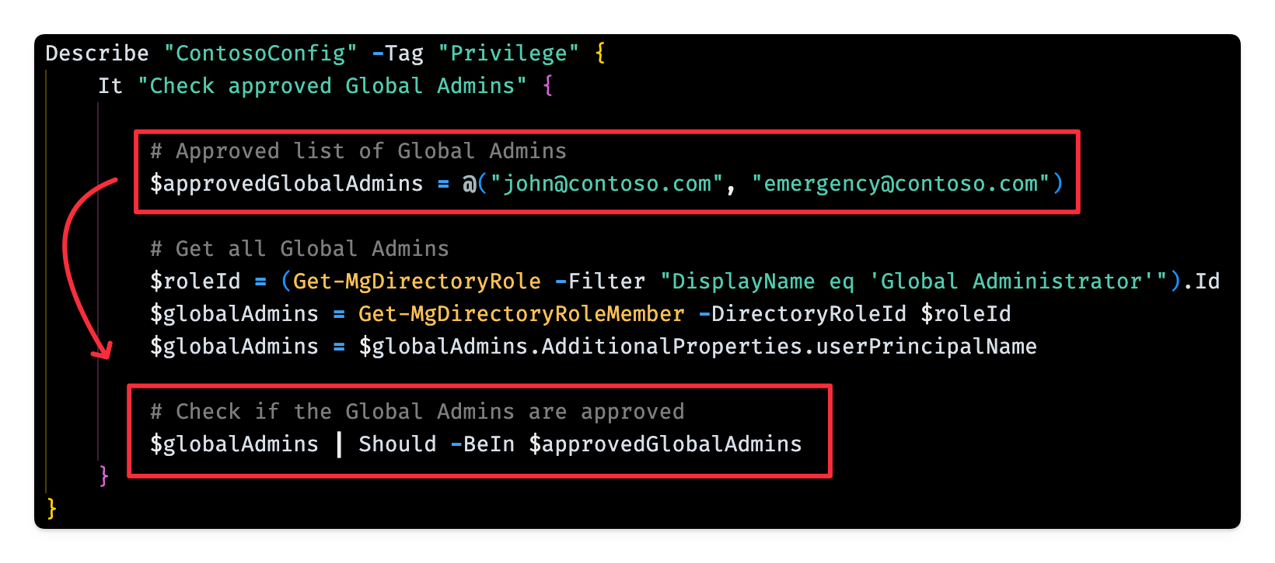
Writing custom tests
Notes:
This was the original intention for Maester, the ability to write custom tests.
Open up this page and show how there is a step by step guide to write custom tests.
https://maester.dev/docs/writing-tests

Slide 13
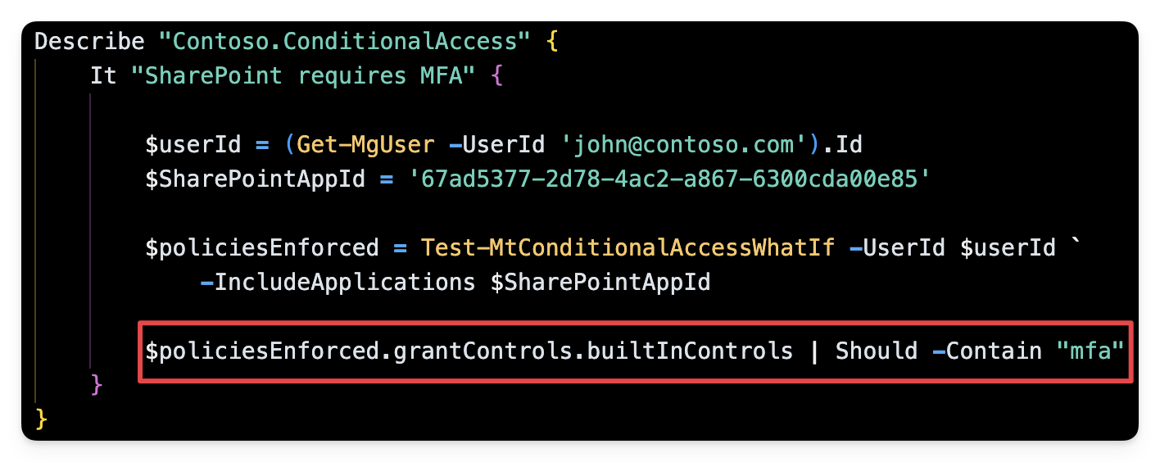
Conditional access - What If Tests
Notes:
Show a demo of the What If option in the Entra admin CA portal and walk through some of the tests in https://maester.dev/docs/ca-what-if

Slide 14
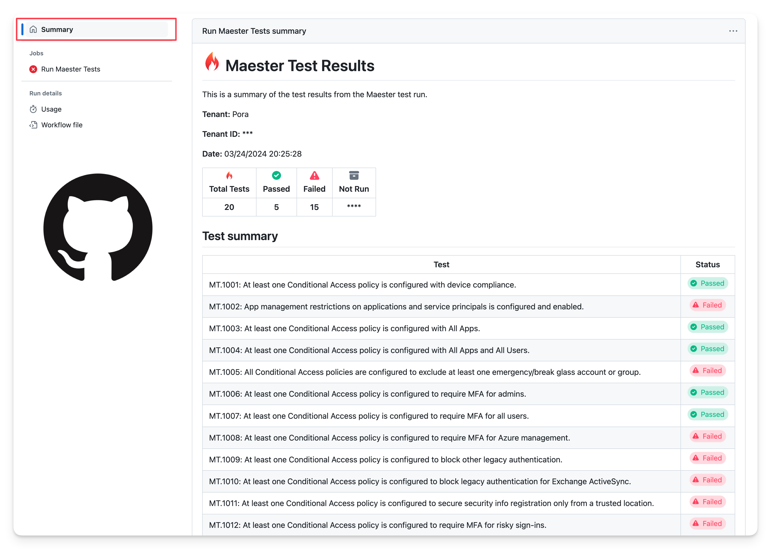
GitHub and Azure DevOps Integration
Notes:
If you have time show a demo of it in GitHub, if this is a long workshop you can even follow the steps and show it being set up.

Slide 15
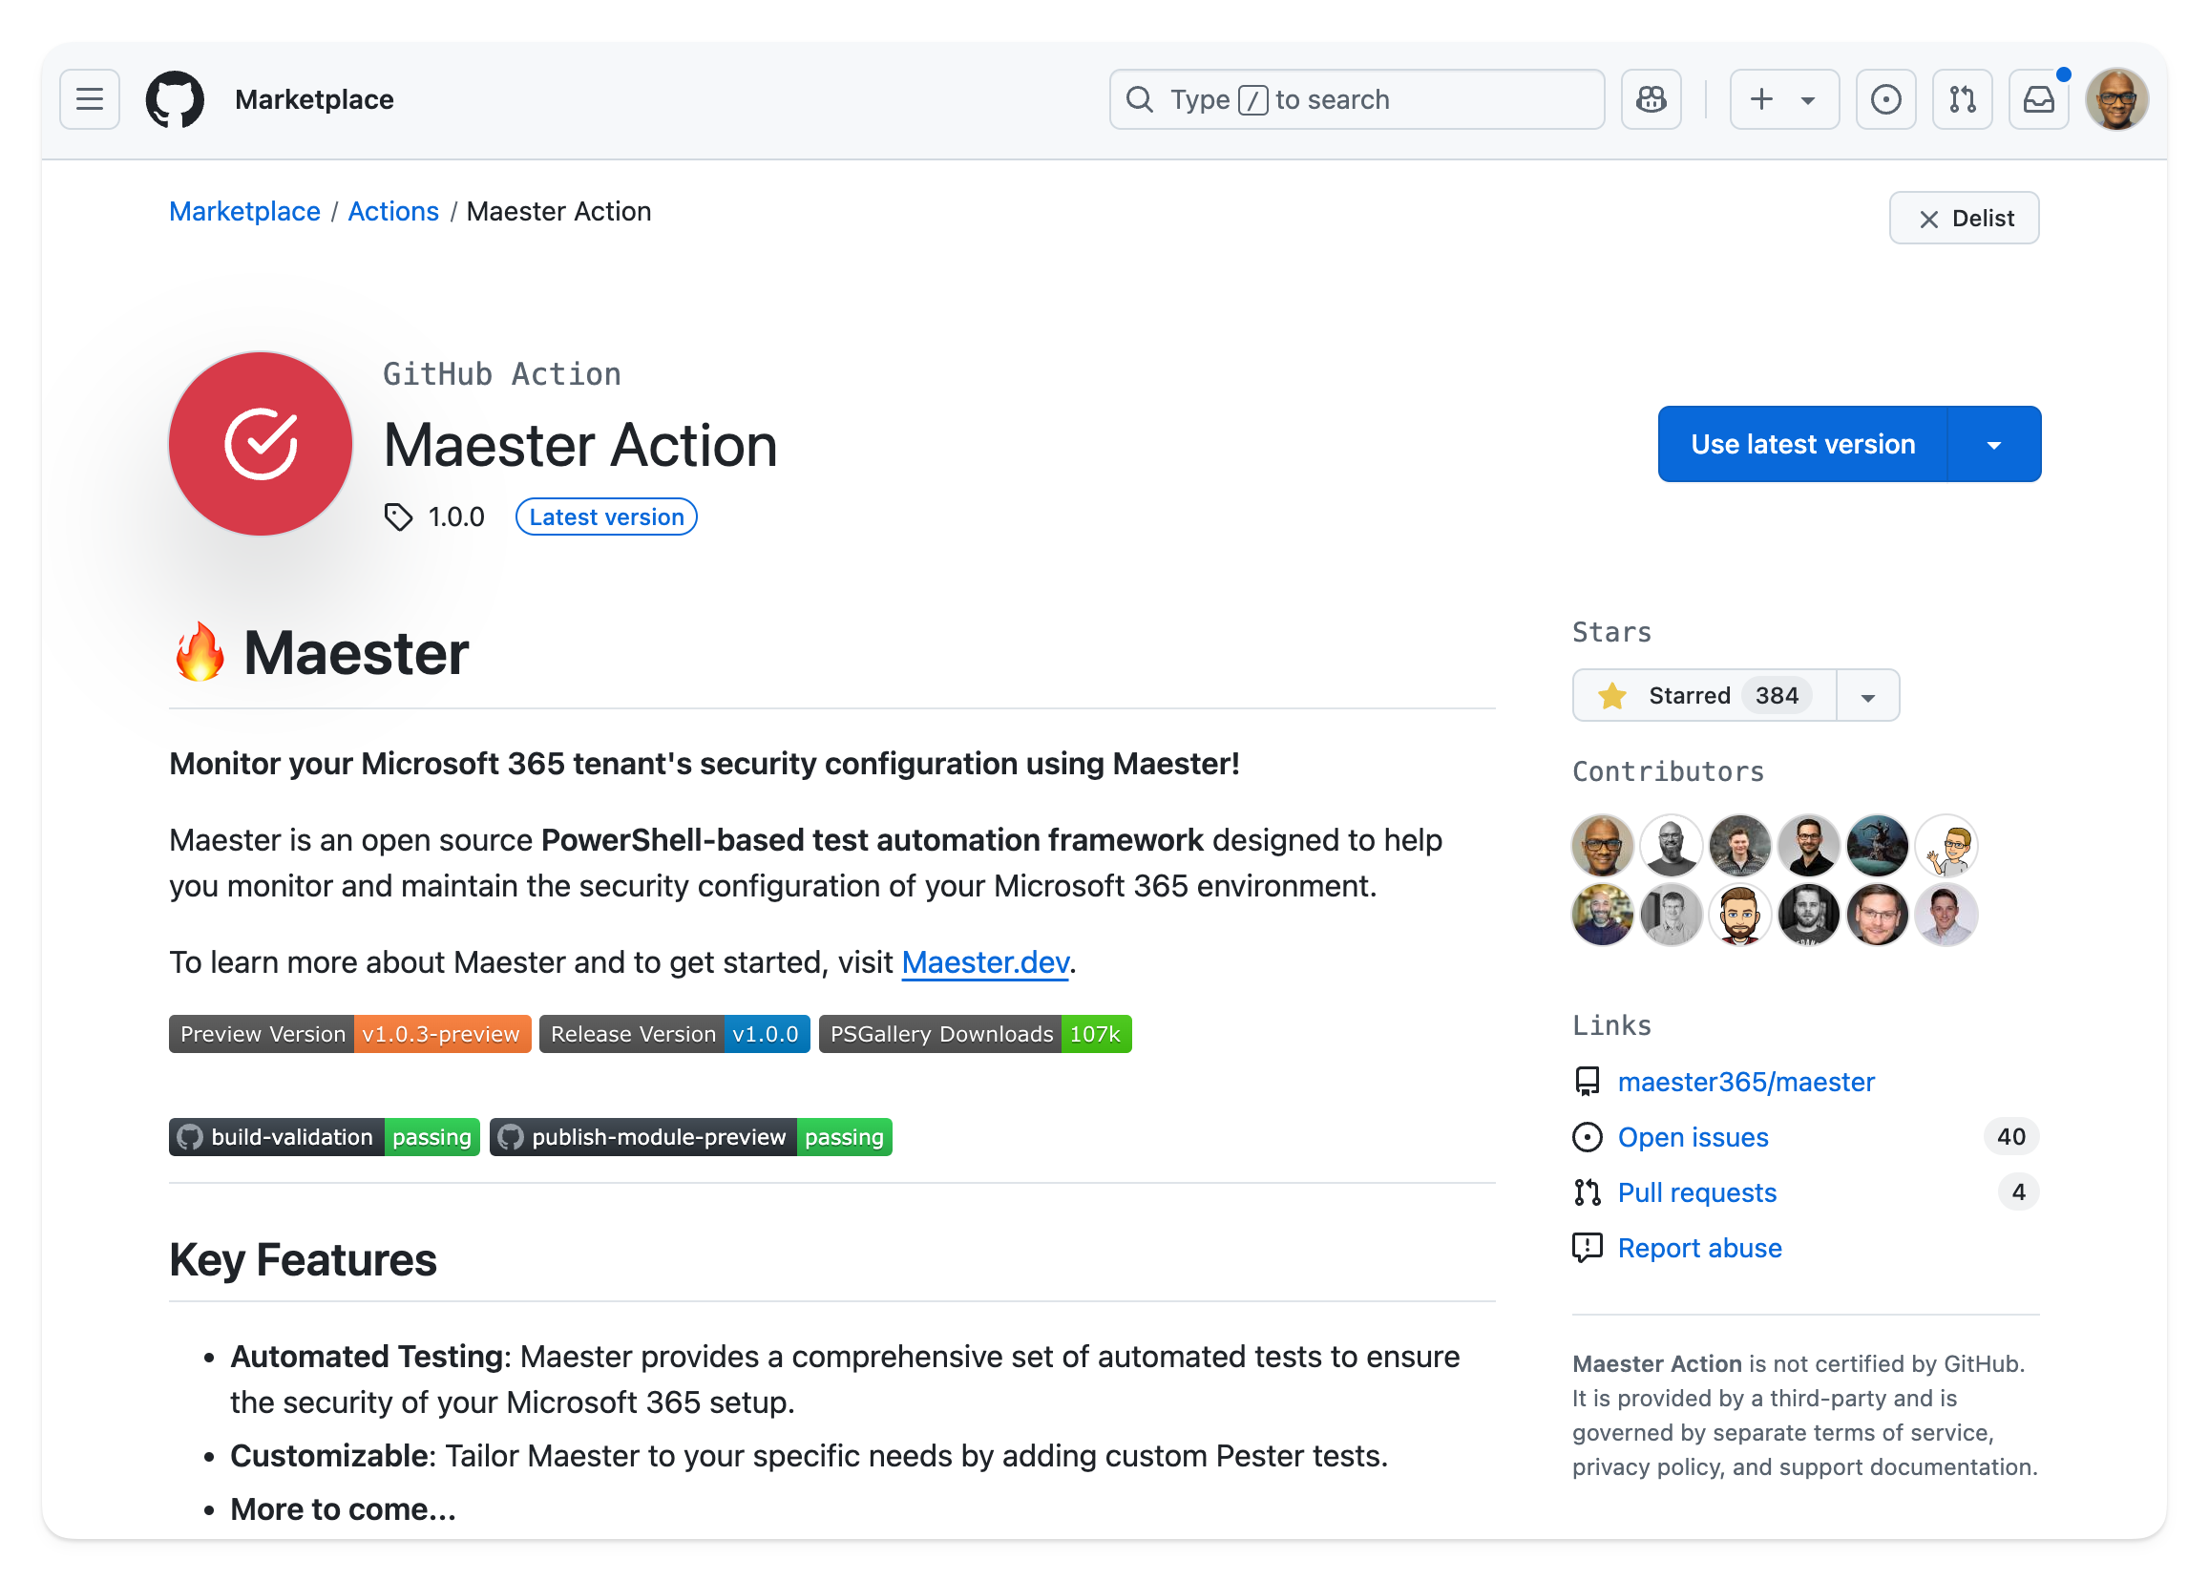
GitHub Action
Notes:
Demo setting up automation with workload identity federation

Slide 16
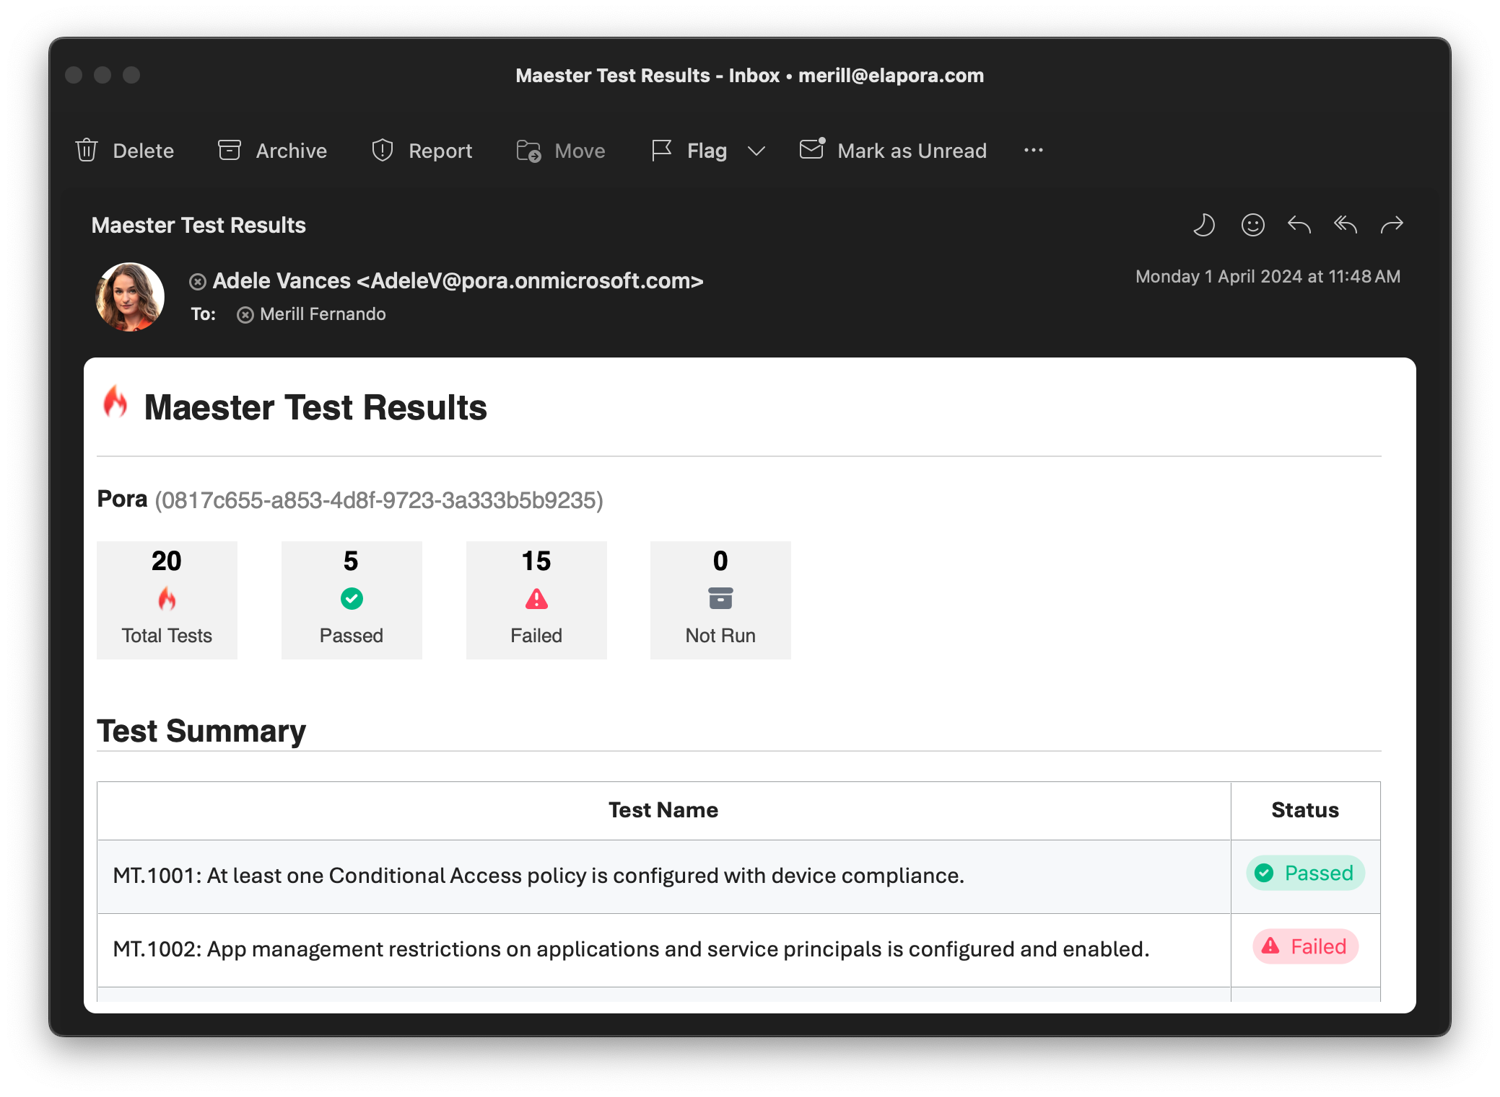
Maester Email Alerts
Notes:
Show demo running from command line

Slide 17
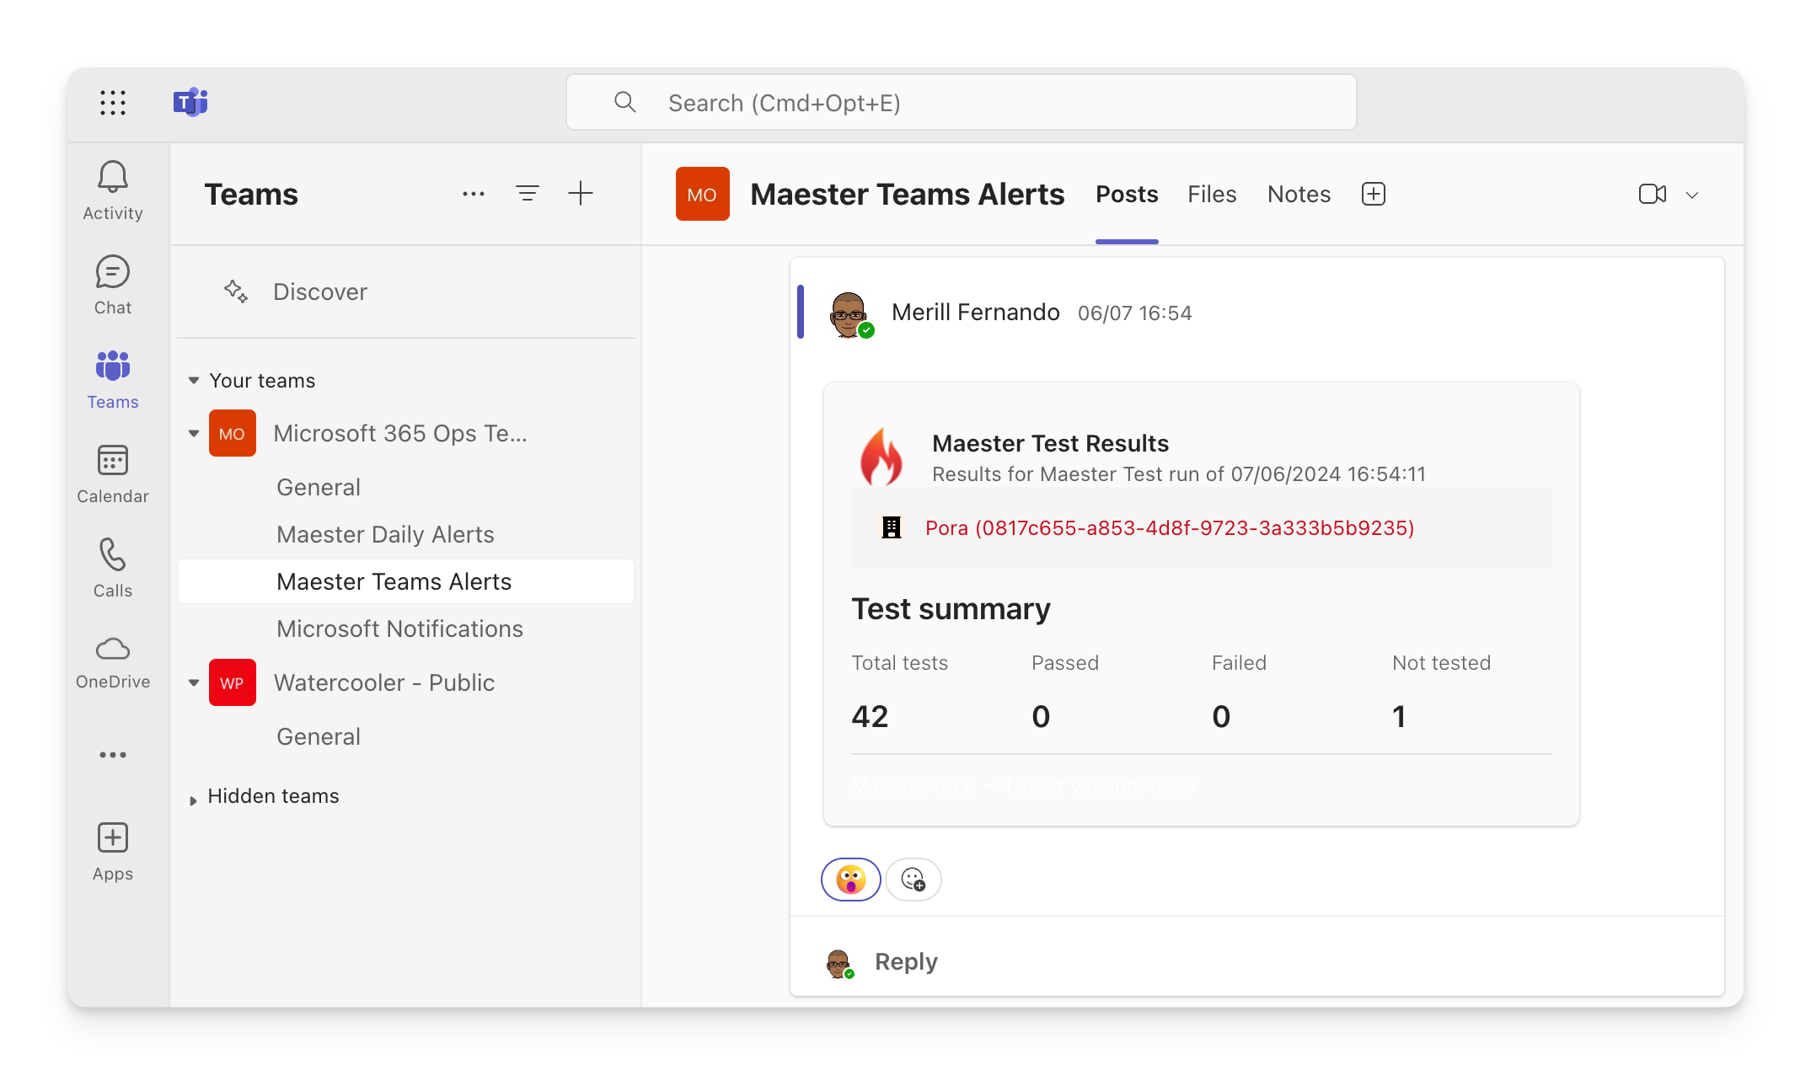
Teams Alerts
Notes:
Show demo running from command line

Slide 18
Found a security configuration issue?
How do you keep it from happening again in the future?
Write a test in Maester! Of course.
Build this out over time and you will have your organization’s security configuration as code.
Notes:
Show the out of the box tests as well as the documentation for Maester

Slide 19
THANK YOU
Please review this session

